Slide 2
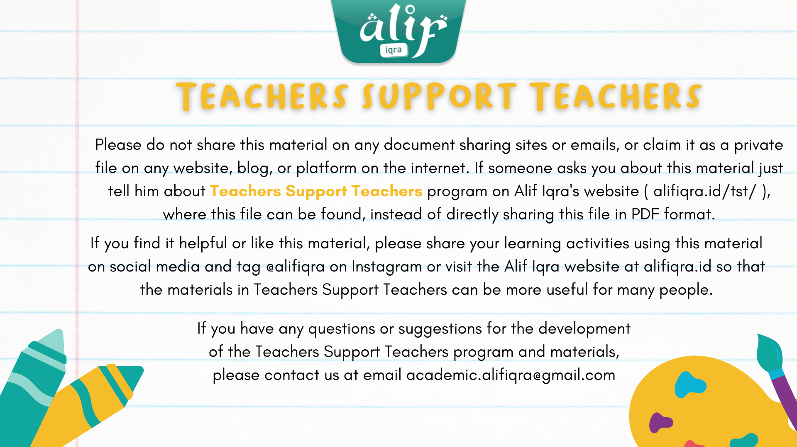

Slide 3
Car Parking
Let’s play together!
by : Ms. Andin

Slide 4
Part 1
Tilawati 2

Slide 5
Mengenal Harakat
Fathah
Berbunyi “A”
Kasrah
Berbunyi “i”
اَ بَ تَ
جِ كِ دِ

Slide 6
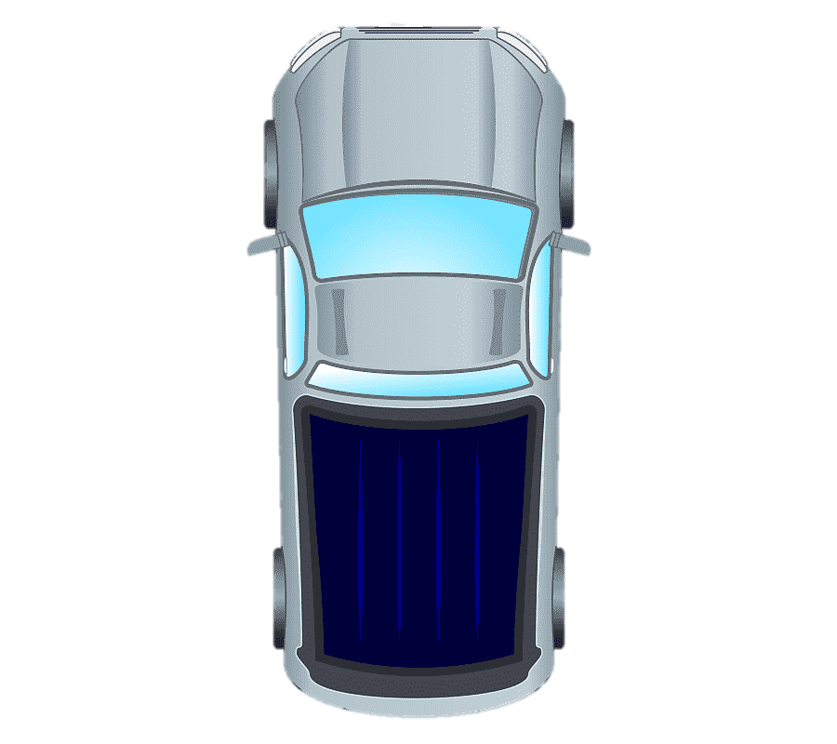
Start here
وَلَدَ
شَهَدِ
حَضَرَ
كَتَبِ

Slide 7
Start here
عَلِمَ
مَرِضَ
فَرِحَ
ظَلِمَ

Slide 8
Alhamdulillah selesaii ☺
Terima kasih dan sampai bertemu lagi insyaAllah

Slide 9
Sumber :
Materi ini diambil dari buku tilawati II
Materi disusun menggunakan aplikasi power point
Beberapa gambar pendukung diambil dari google dengan link berikut :
https://www.google.com/search?q=gambar+mobil+png+animasi&tbm=isch&ved=2ahUKEwj3tcrP9LT0AhVEfn0KHTIkBckQ2-cCegQIABAA&oq=gambar+mobil+png&gs_lcp=CgNpbWcQARgBMgUIABCABDIFCAAQgAQyBQgAEIAEMgUIABCABDIFCAAQgAQyBQgAEIAEMgYIABAHEB4yBggAEAcQHjIGCAAQBxAeMgYIABAHEB46BwgjEO8DECdQkSBYlTVgxEFoAXAAeACAAT-IAYYDkgEBN5gBAKABAaoBC2d3cy13aXotaW1nwAEB&sclient=img&ei=8TygYbf5OMT89QOyyJTIDA&bih=657&biw=1366#imgrc=NpyHAbT8FEoQKM
https://www.google.com/search?q=gambar+kartun+area+parkir+tampak+atas&tbm=isch&ved=2ahUKEwjqjoKygLX0AhVBkksFHTaJBK0Q2-cCegQIABAA&oq=gambar+kartun+area+parkir+tampak+atas&gs_lcp=CgNpbWcQAzoHCCMQ7wMQJ1CnBVipE2CgFWgAcAB4AIABbIgBvQSSAQM2LjKYAQCgAQGqAQtnd3Mtd2l6LWltZ8ABAQ&sclient=img&ei=SUmgYarGCcGkrtoPtpKS6Ao&bih=600&biw=1349&hl=id#imgrc=UUzYve0Ae40efM
https://www.google.com/search?q=gambar+mobil+png+animasi&tbm=isch&ved=2ahUKEwj3tcrP9LT0AhVEfn0KHTIkBckQ2-cCegQIABAA&oq=gambar+mobil+png&gs_lcp=CgNpbWcQARgBMgUIABCABDIFCAAQgAQyBQgAEIAEMgUIABCABDIFCAAQgAQyBQgAEIAEMgYIABAHEB4yBggAEAcQHjIGCAAQBxAeMgYIABAHEB46BwgjEO8DECdQkSBYlTVgxEFoAXAAeACAAT-IAYYDkgEBN5gBAKABAaoBC2d3cy13aXotaW1nwAEB&sclient=img&ei=8TygYbf5OMT89QOyyJTIDA&bih=657&biw=1366#imgrc=w8058j_qLtLqBM

