Slide 1
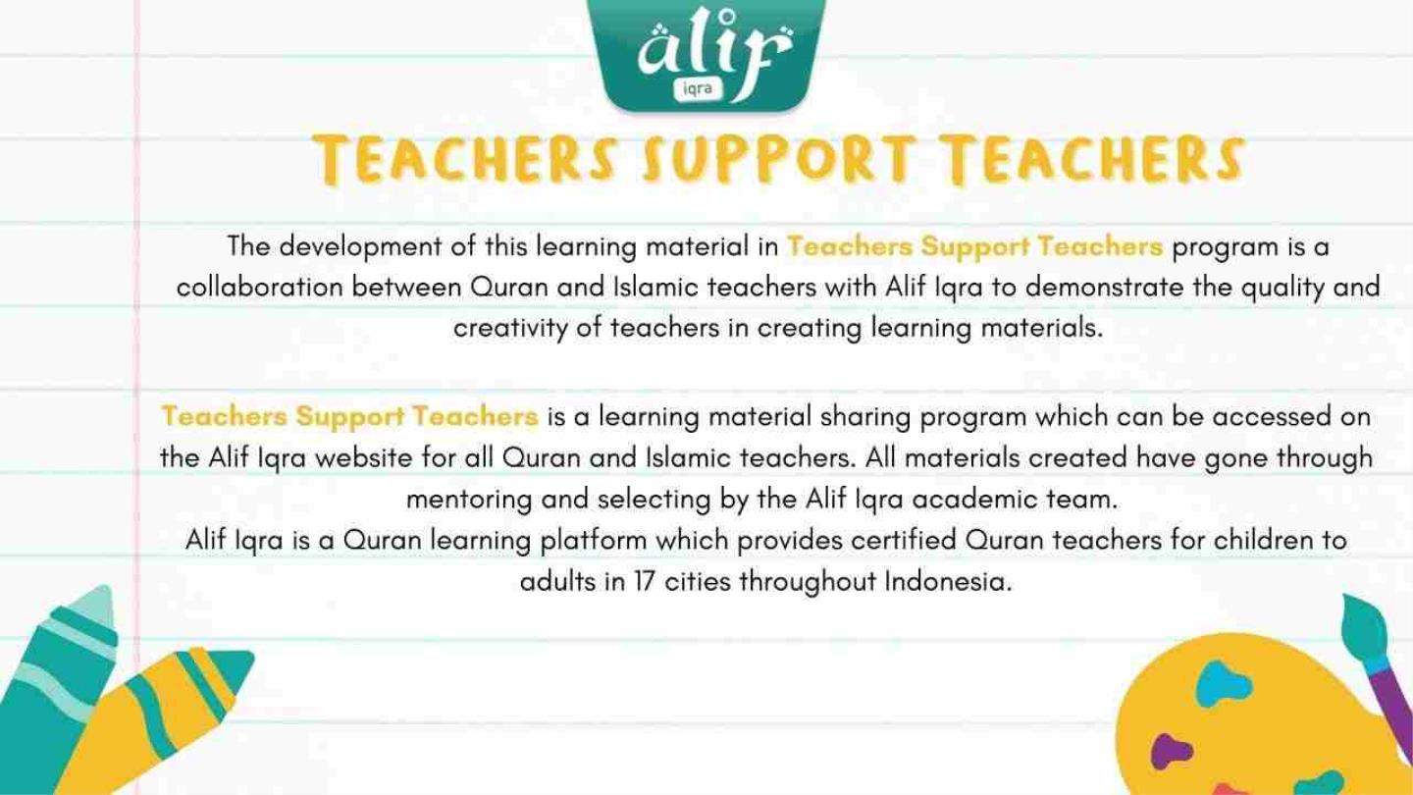

Slide 2
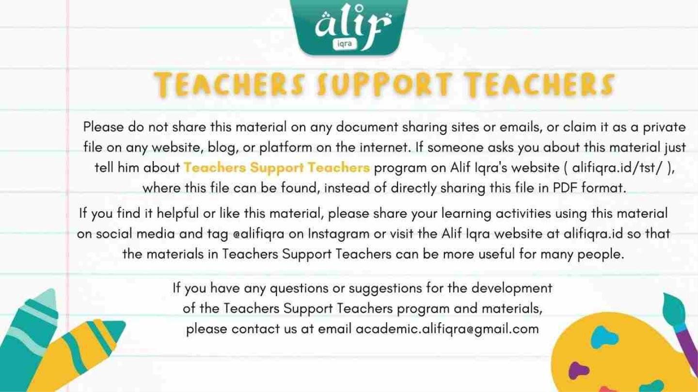

Slide 3

HELPING
OTHERS
Design by Kartika Sari
PPT editing by Slide Go
Material Source :
Saaliha Ali’s Book
World of Islam Portal

Slide 4

Make it easier for to do
something by offering one
resources
Help / Tolong

Slide 5

01 02 03 04
Make
You
Feel
Give
in
Charity
Safety
of
the
society
Spread
of
Love
Great

Slide 6

Me and You (We) can
help others in the world :
All the living things, such
as :
People, plants and
animals
In the Quran, Allah (swt) says: “Help
one another in acts of piety and
righteousness. And do not assist each
other in acts of sinfulness and
transgression. And be aware of Allah.
Verily, Allah is severe in punishment”
(Quran 5:2).

Slide 7

Every
Time
Whenever
If you are
really can not
help, you can
help others by
praying
Stop to help
when needed
only

Slide 8

Help not one another unto
sin and transgression, but
keep your duty to Allah. Lo!
Allah is severe in
punishment
Qs Al Maidah : 2

Slide 9

Smile
Patient
Pity
How
do we
help
others
?
Listen
Polite
Be Kind
Sincery
Care

Slide 10

Look at the colour code and answer
by writing yes/no for the helping
activities.
Tidy up
Blood
drive
Playing Feed the
all the
time
fish
Wash the Laying
dishes
on the
bed
Let’s Put away
Donate the toys

Slide 11
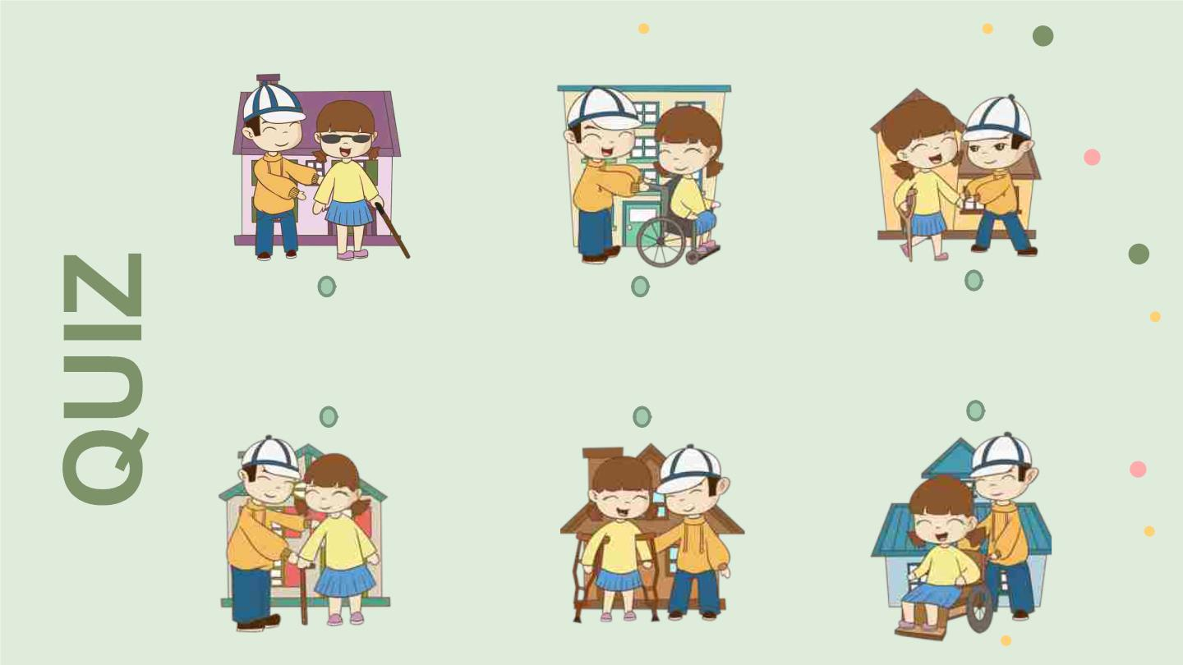
Match to the same activities

Slide 12
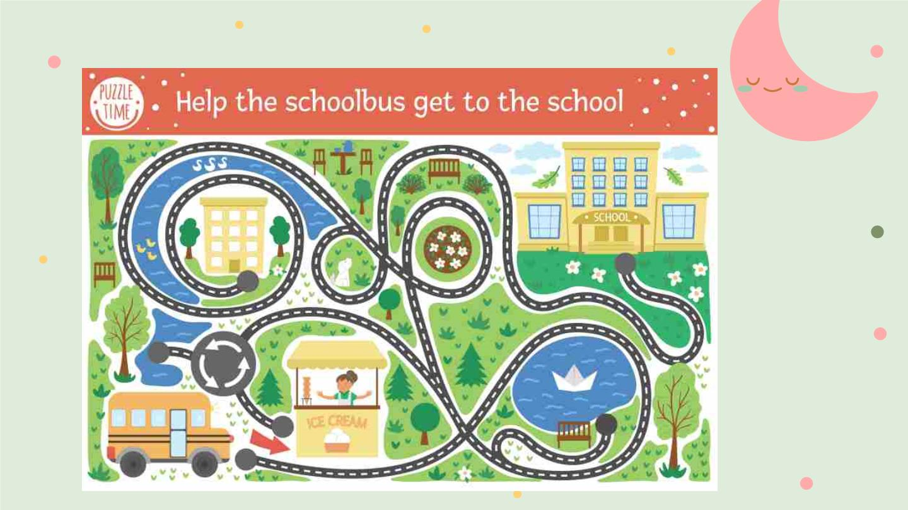
Brain Sheet

Slide 13


Slide 14
